Slide 1
Welcome to PExl

Slide 2
Welcome
Welcome to PExL and thank you for participating in today’s experiment.
Please place all of your personal belongings away so that we can have your complete attention.
Please use the laptops as instructed. In particular, please do not attempt to browse the web or use programs unrelated to the experiment.

Slide 3
Guidelines
You will be paid in private and in cash at the end of the experiment.
The amount that you ultimately earn in the experiment depends on your decisions, the decisions of others, and random chance. You have each earned a $10 payment for showing up on time.
You will be using laptops for the entire experiment, and all interactions between yourself and others will take place via the laptop’s terminal.
Please DO NOT socialize or talk during the experiment.

Slide 4
Today’s Experiment is about Group Decisions
You will be making decisions in groups containing two other individuals.
You will receive information over time that can help you make a profitable decision.
However, waiting for this information is costly.

Slide 5
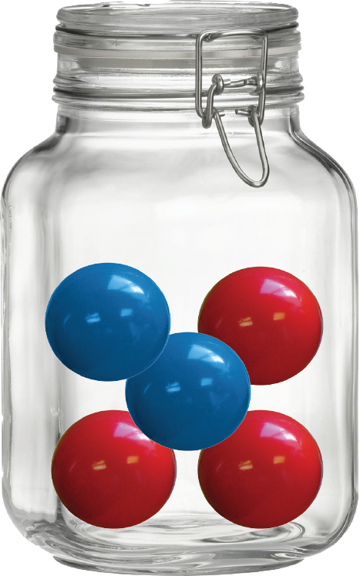
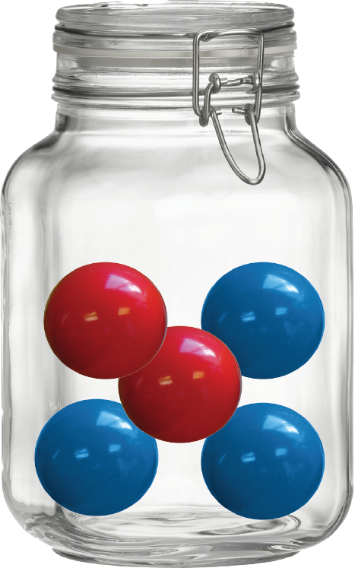
Two Options
At the outset, one of two jars is selected at random, with equal probability: A (for Amaranth) or B (for Blue).
A
B

Slide 6
Two Options
We will not tell you which jar had been selected:
?

Slide 7
Two Options
(Jars) A and B are equally likely.
You will not know which one had been selected.
Your goal is to guess the jar that had been selected: A or B.
You and all members of your group will receive 200 tokens for a correct guess, 0 for an incorrect guess.

Slide 8
Information
You will be able to acquire information about the state or jar that had been selected prior to making your guess.
This information will come at a cost (details soon).

Slide 9
Information
Information arrives over time
A consequence of noise added to a simple process
We will start with the simple process

Slide 10
Information – simple process
Suppose that when A is selected, at any time t, you observe the signal 0.84*t
  After 0.5 minutes, observe 0.84*0.5 = 0.42
  After 1 minute, observe 0.84*1 = 0.84
Suppose that when B is selected, at any time t, you observe the signal -0.84*t
  After 0.5 minutes, observe -0.84*0.5 = -0.42
  After 1 minute, observe -0.84*1 = -0.84
You can tell whether A or B were selected by the sign of the signal

Slide 11
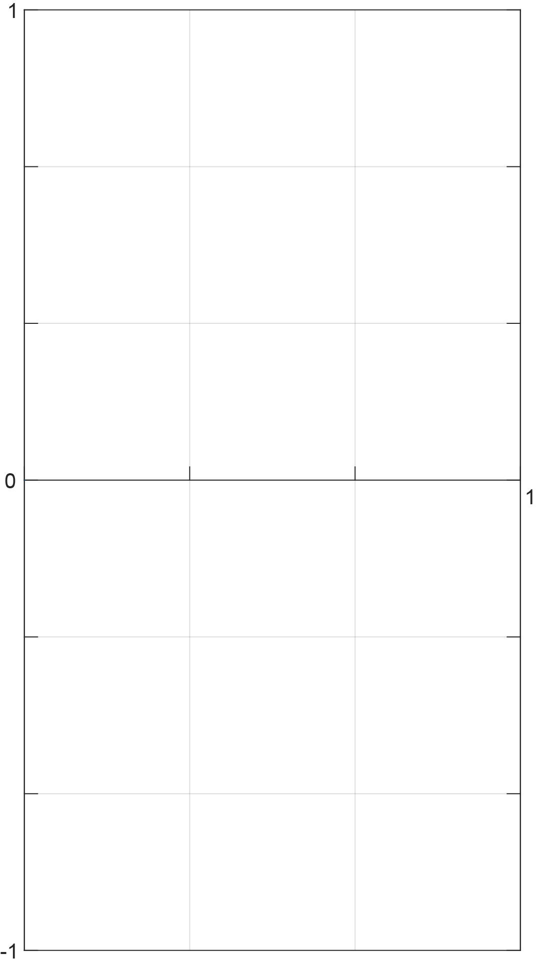


Information – simple process
Amaranth
signal
Blue
signal
Time

Slide 12
Information – simple process
This is not an interesting way to provide you information: you can immediately tell whether A or B had been selected by the sign of the signal
Now suppose we add some noise at any point in time

Slide 13
noise: first step
Think of an individual standing on the straight line, at point 0
-2
-1
0
1
2

Slide 14
noise: first step
Think of an individual standing on the straight line, at point 0
At each period, the individual determines where he walks according to a coin toss: right if heads, left if tails
-2
-1
0
1
2

Slide 15
noise: first step
Think of an individual standing on the straight line, at point 0
At each period, the individual determines where he walks according to a coin toss: right if heads, left if tails
-2
-1
0
1
2

Slide 16
noise: first step
Think of an individual standing on the straight line, at point 0
At each period, the individual determines where he walks according to a coin toss: right if heads, left if tails
-2
-1
0
1
2

Slide 17
noise: first step
For example, if the individual went right the first time around:
-2
-1
0
1
2

Slide 18
noise: first step
Then, after two periods, the individual will either go right again:
-2
-1
0
1
2

Slide 19
noise: first step
Or left:
-2
-1
0
1
2

Slide 20
noise: first step
So, if we look at the individual’s location on the line over time, it will go back and forth. For example:
location
time

Slide 21
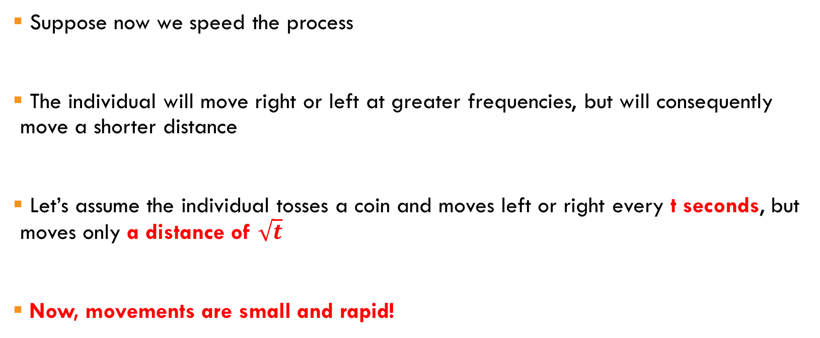
noise: speeding up
Suppose now we speed the process
The individual will move right or left at greater frequencies, but will consequently move a shorter distance
Let’s assume the individual tosses a coin and moves left or right every t seconds, but moves only a distance of $\sqrt{t}$
Now, movements are small and rapid!

Slide 22
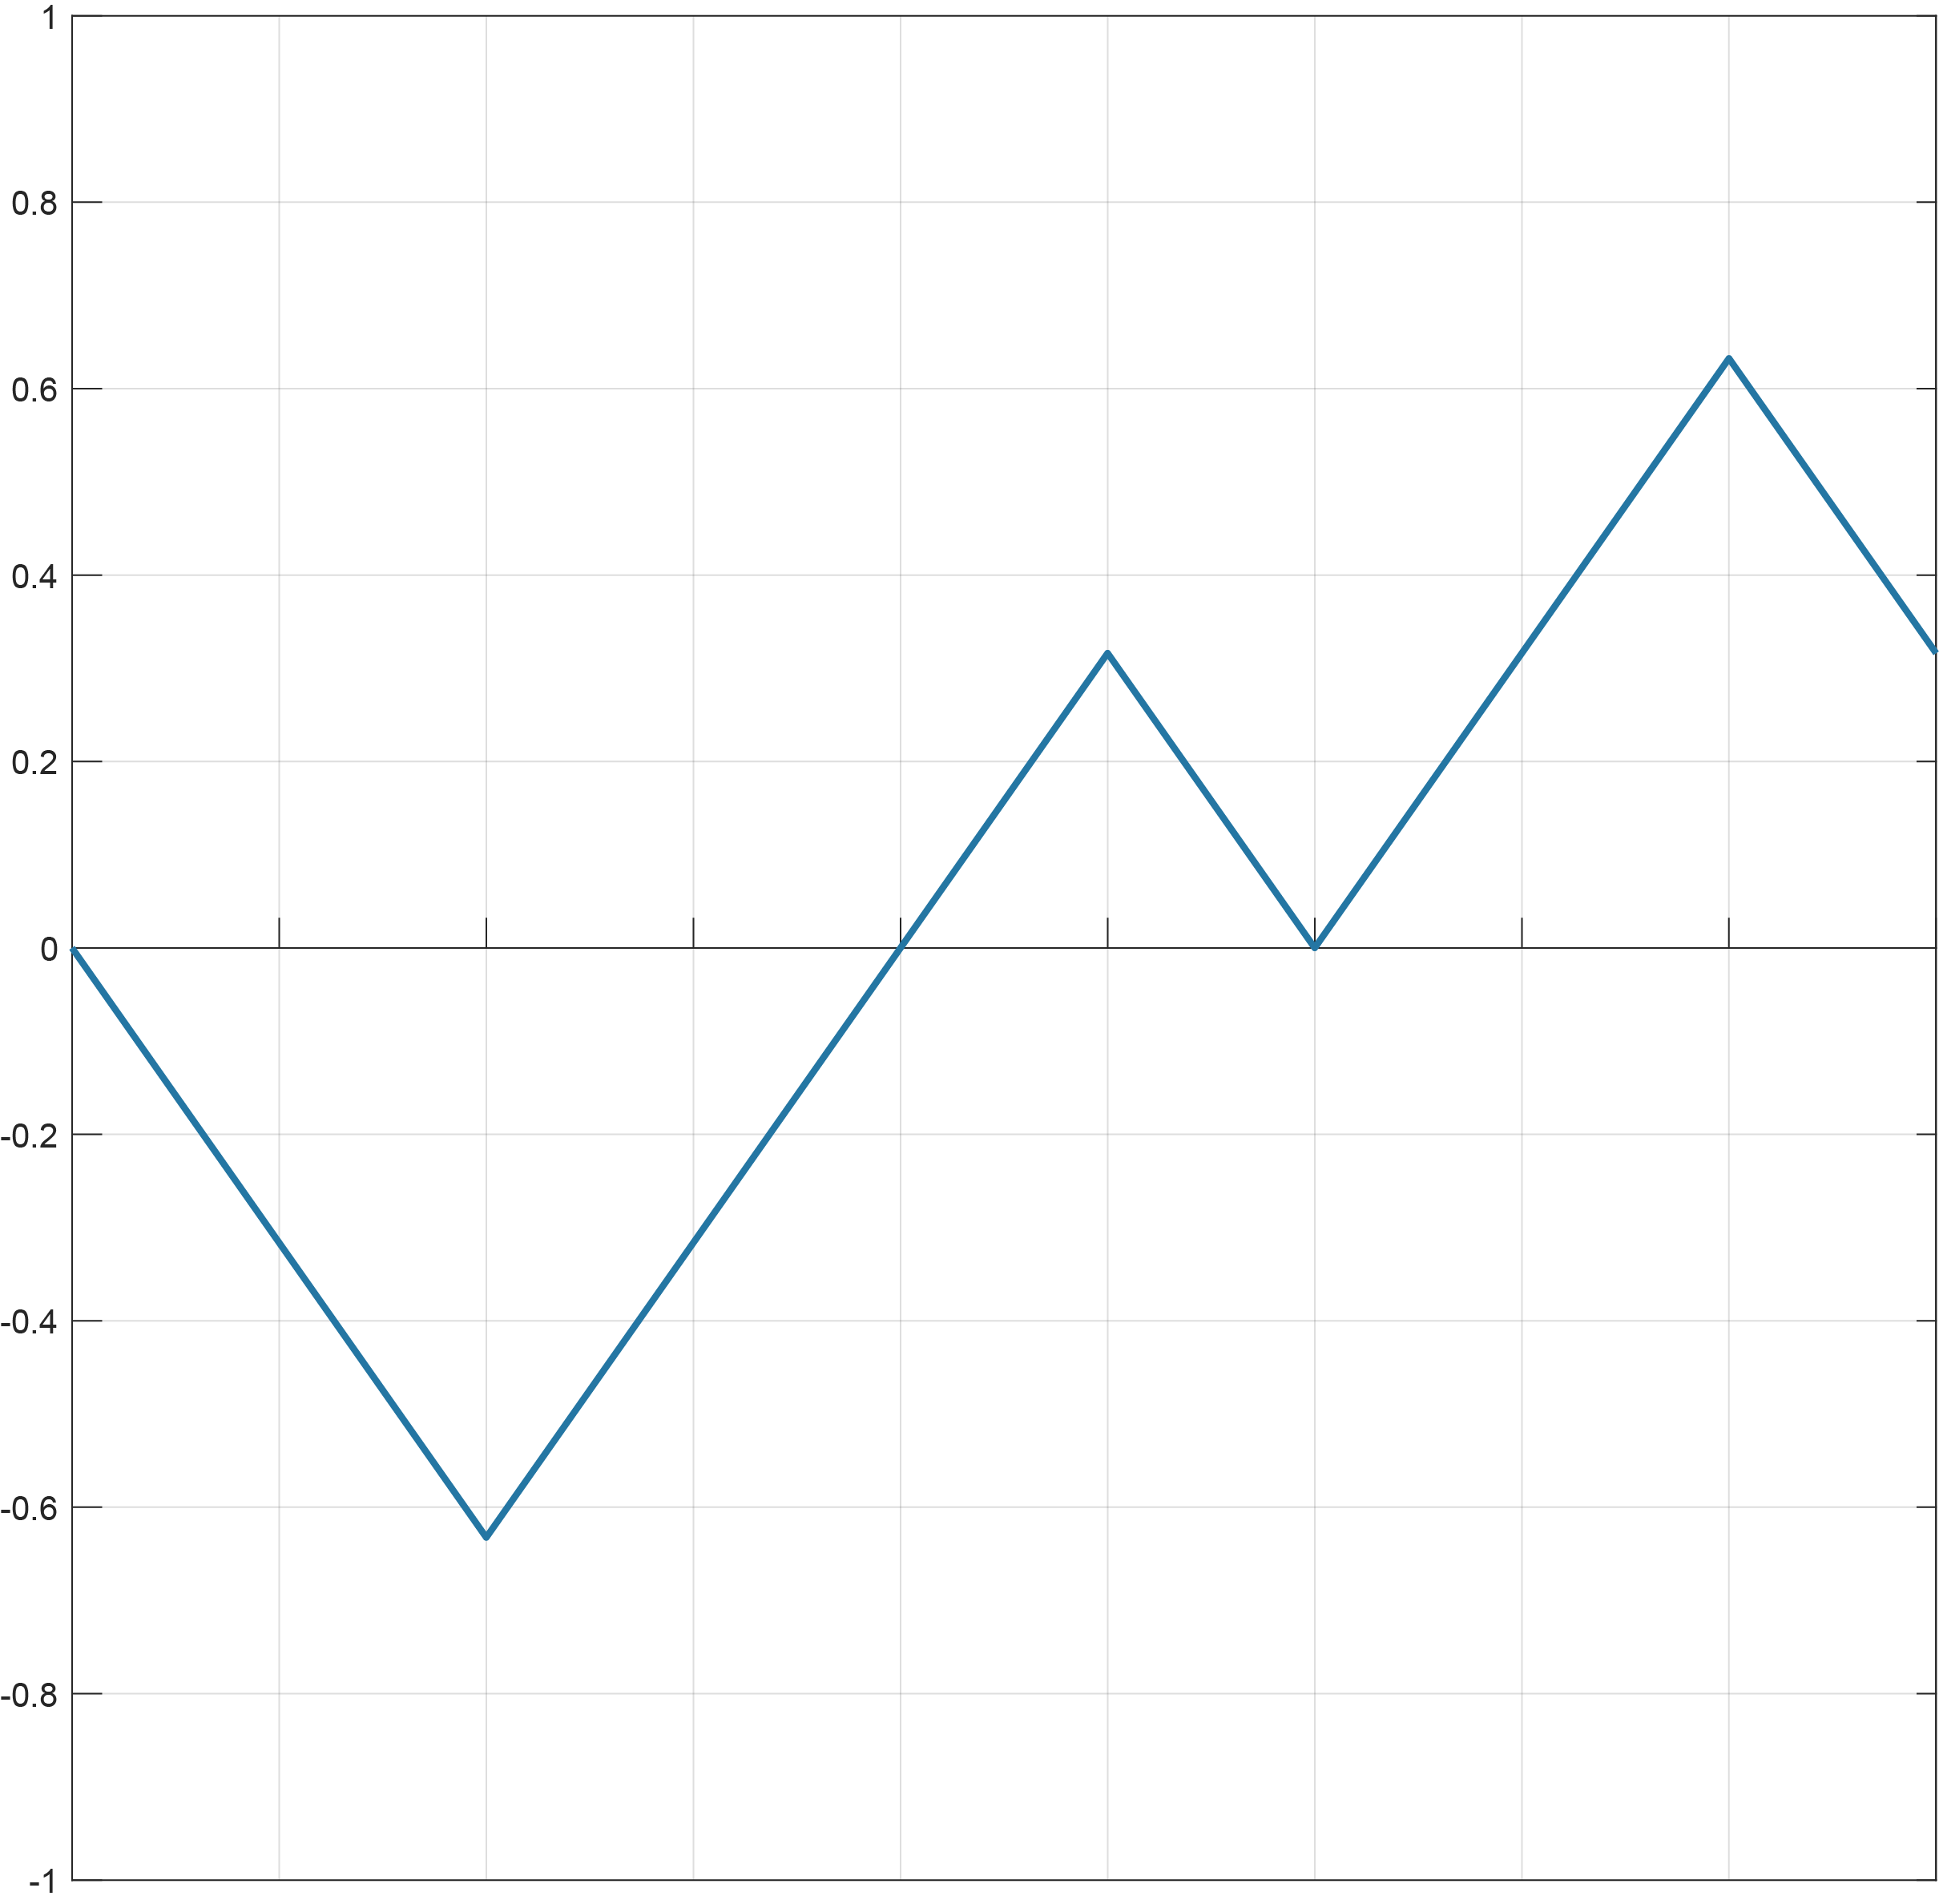
every 0.1 second
location
Time (seconds)

Slide 23
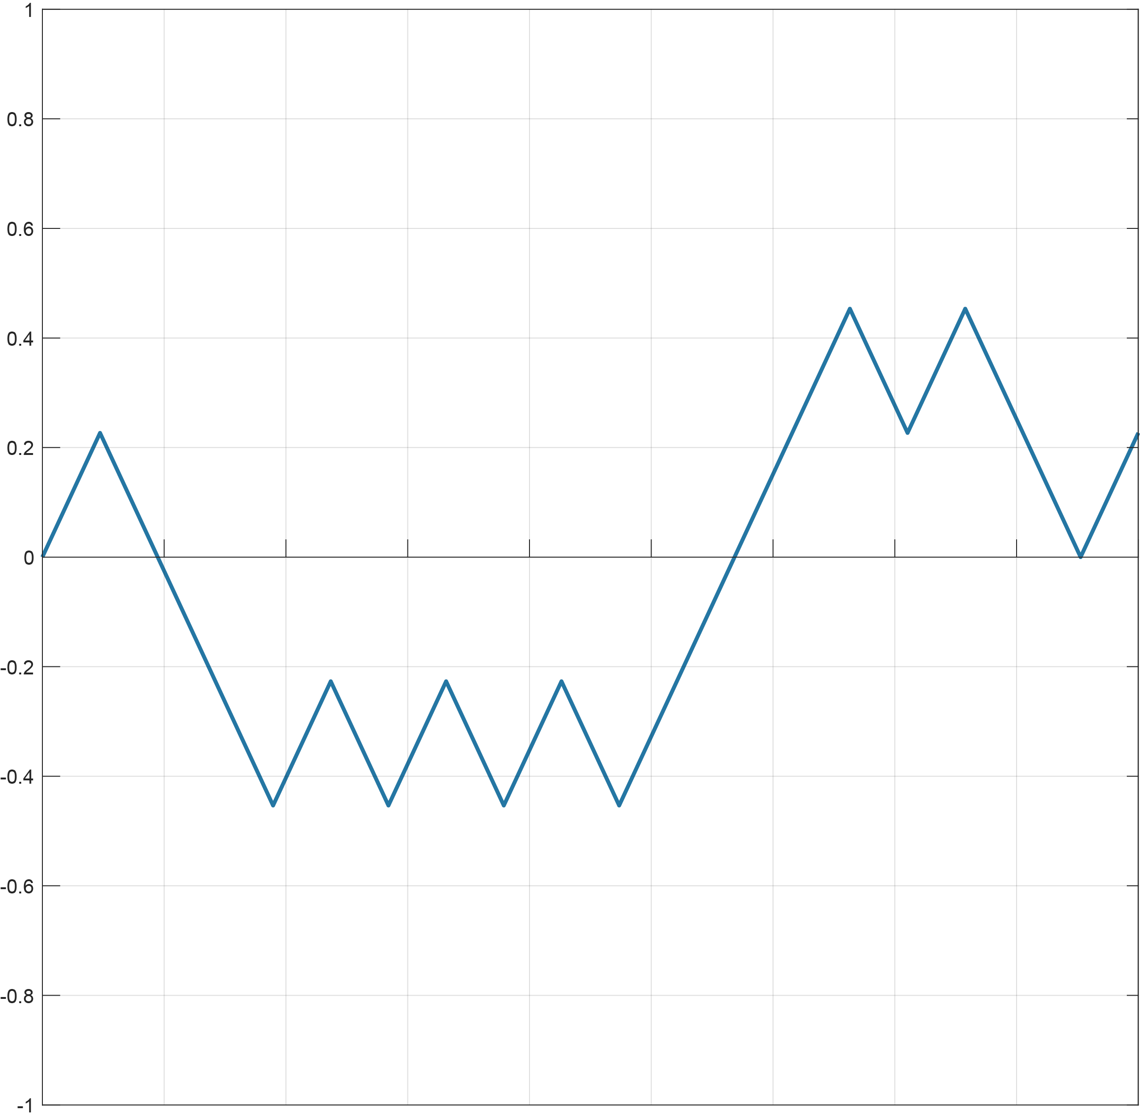
every 0.05 second
location
Time (seconds)

Slide 24
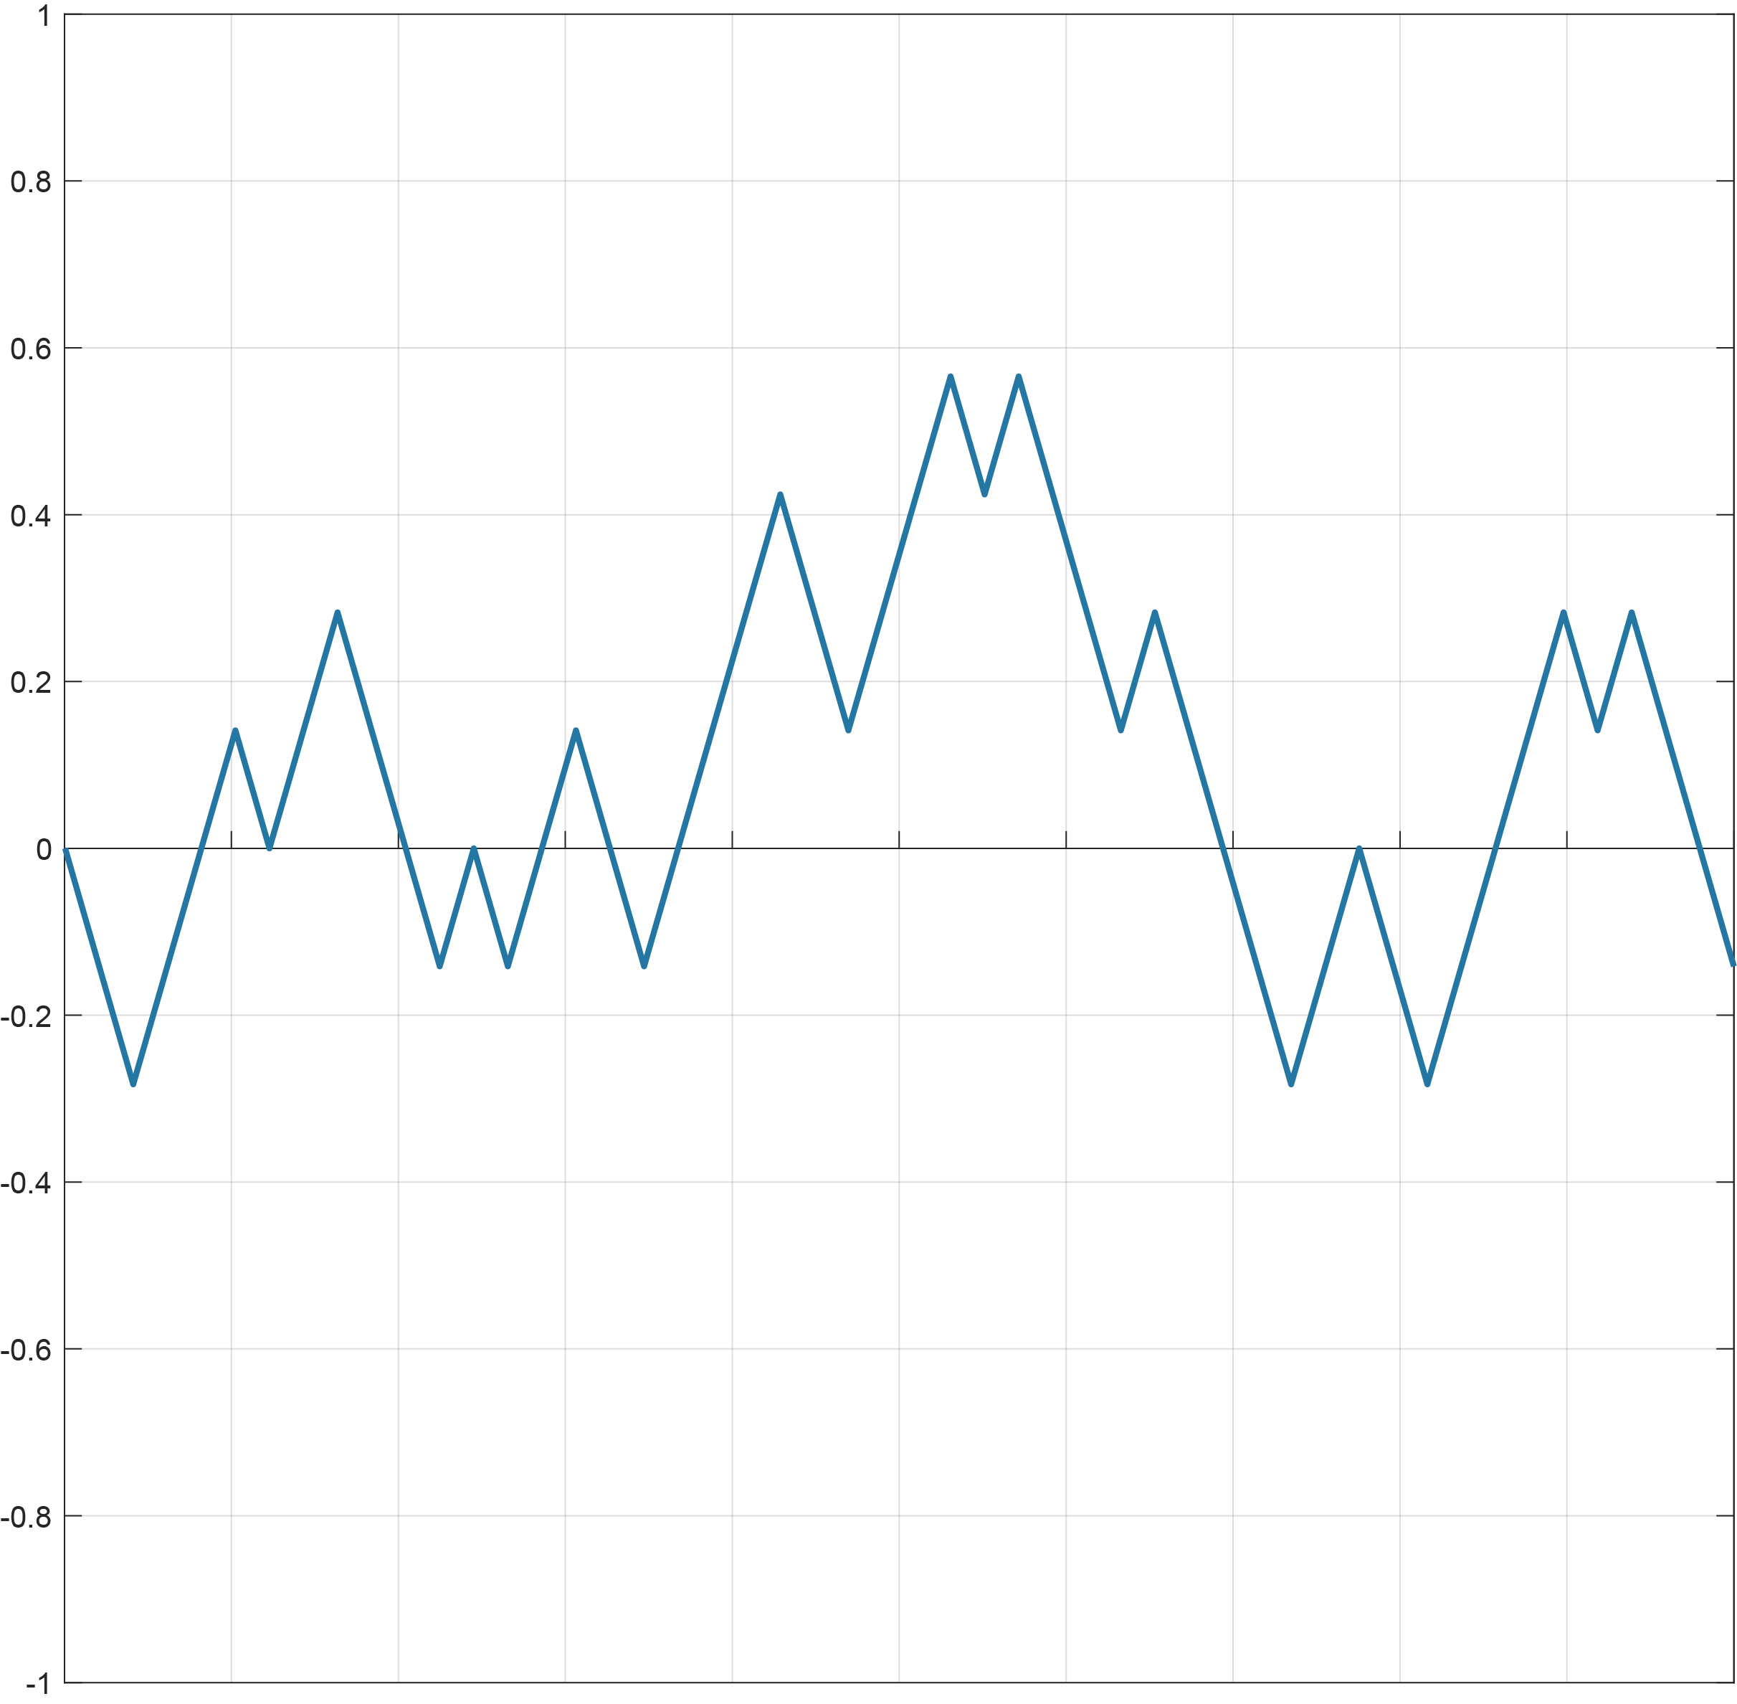
every 0.03 second
location
Time (seconds)

Slide 25
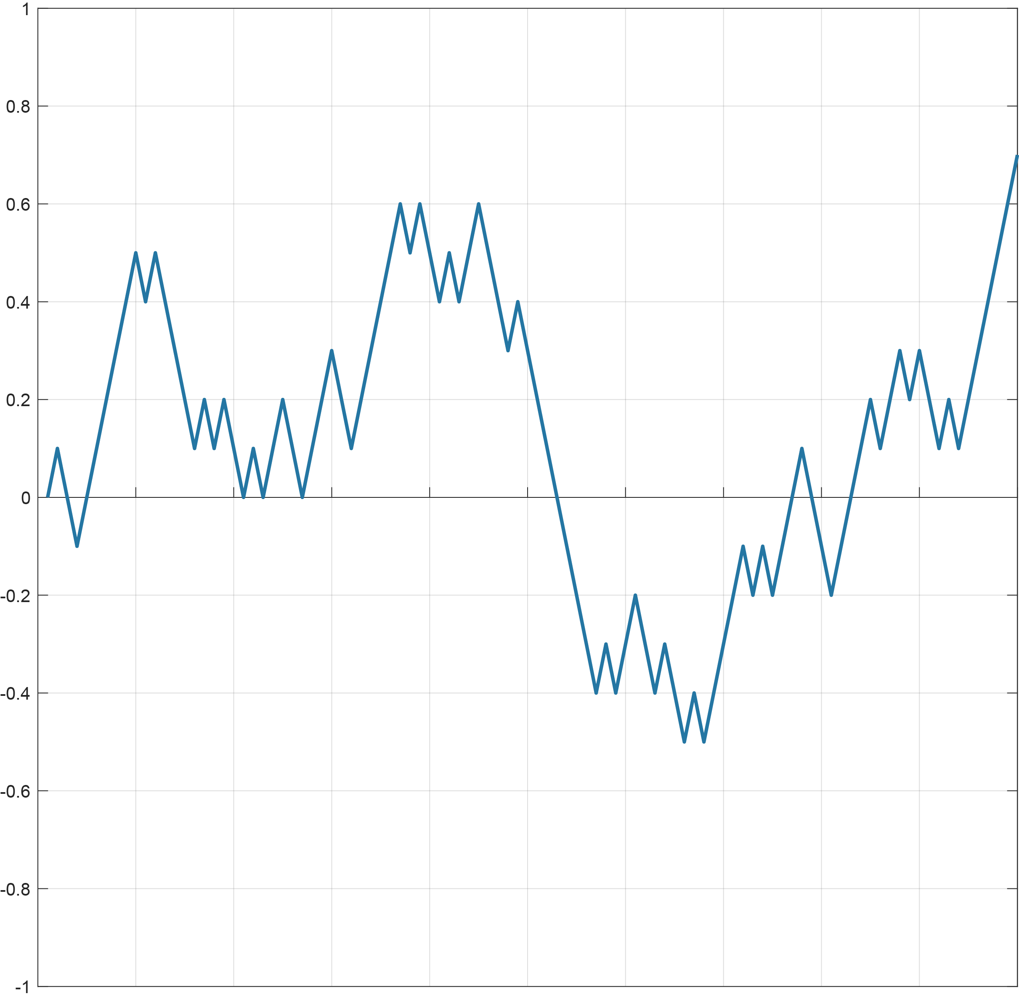
every 0.01 second
location
Time (seconds)

Slide 26
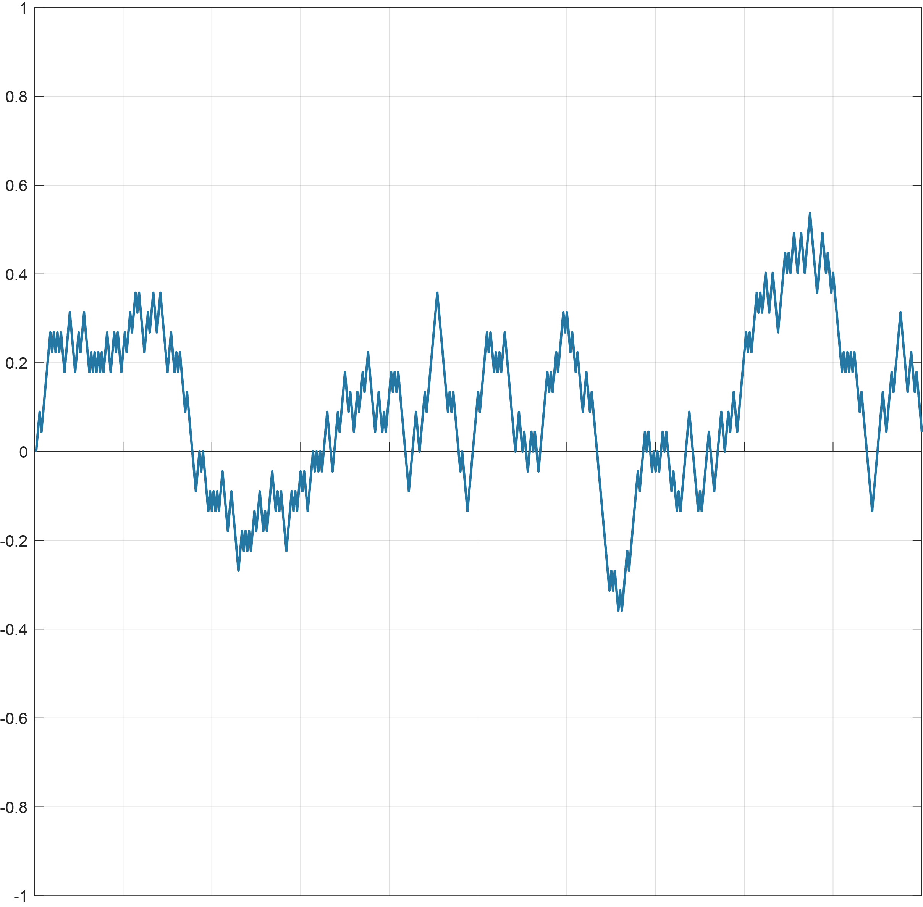
every 0.002 second
location
Time (seconds)

Slide 27
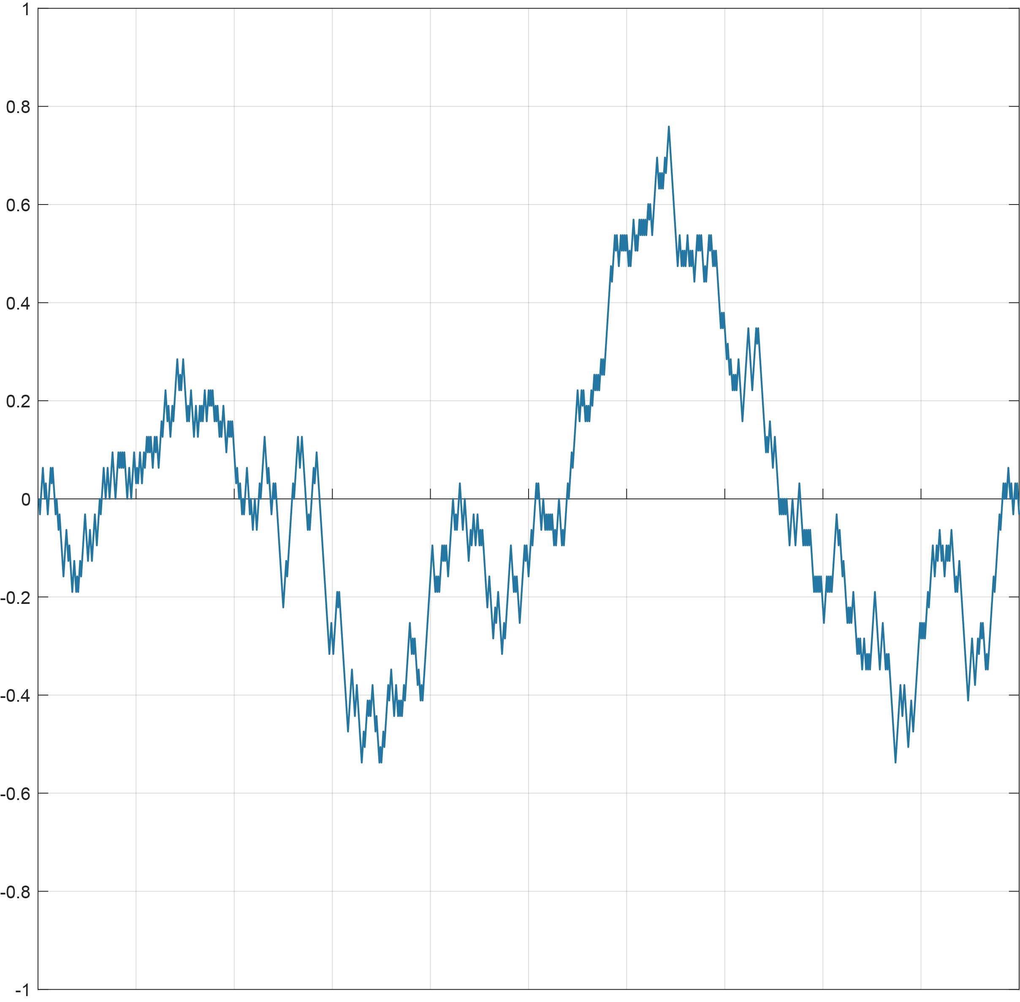
every 0.001 second
location
Time (seconds)

Slide 28
back to information you’ll see
signal
Recall the simple process we described: a signal that increases 0.84 every minute if Jar A (Amaranth) was chosen and decreases 0.84 every minute if Jar B (Blue) was chosen
We will now add the noise with vanishing time intervals to these curves
A
time
B

Slide 29

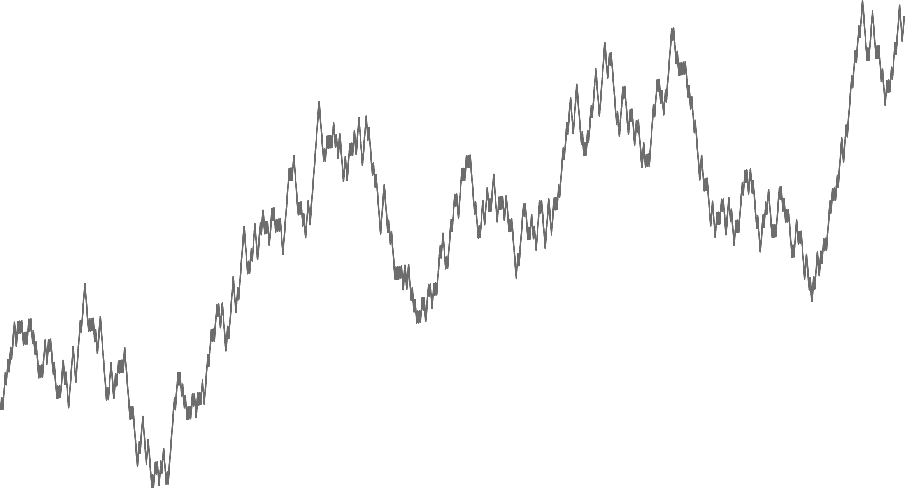

Example
Signal + noise
Amaranth
Blue
Time (seconds)

Slide 30
Information: conclusion
Adding noise still allows you to learn over time: the higher the signal + noise, the more likely it is that A had been selected
In fact, for every value of the signal + noise, a sophisticated statistician can translate what she sees into a probability that A had been selected
Ultimately, that is what we will show you: the probability of A and B over time

Slide 31
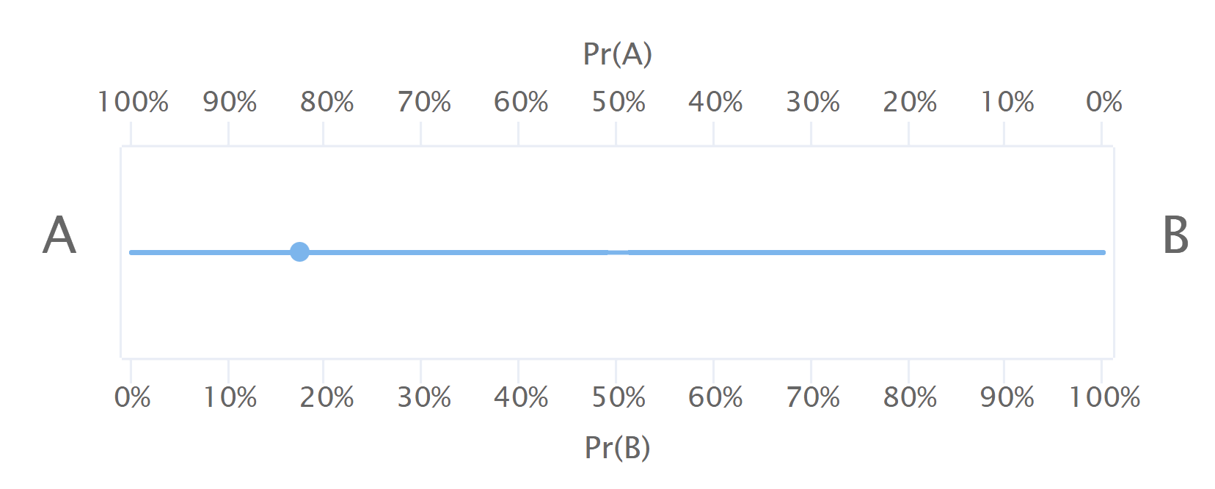
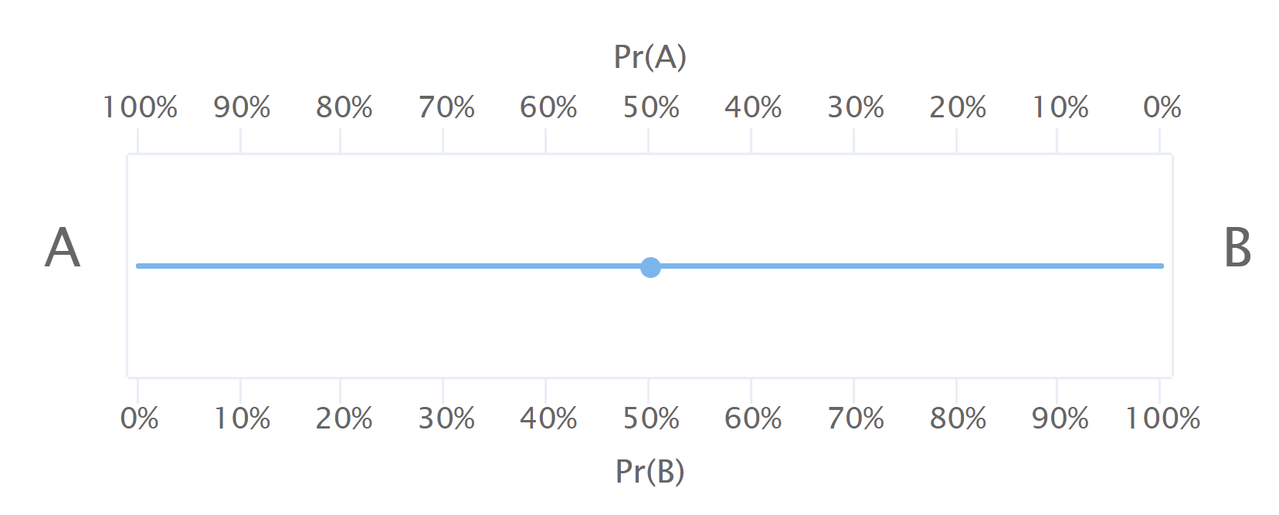
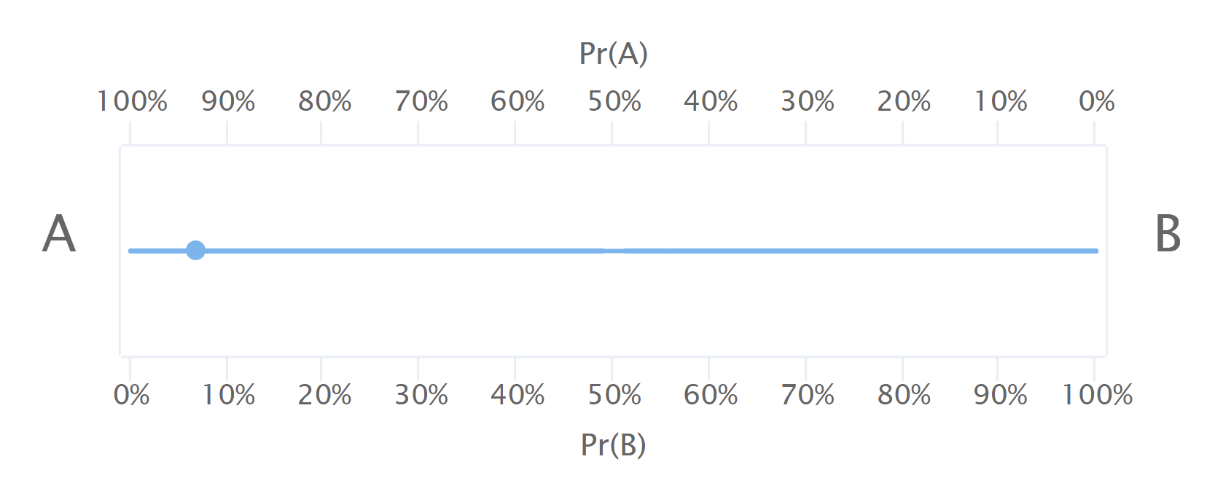
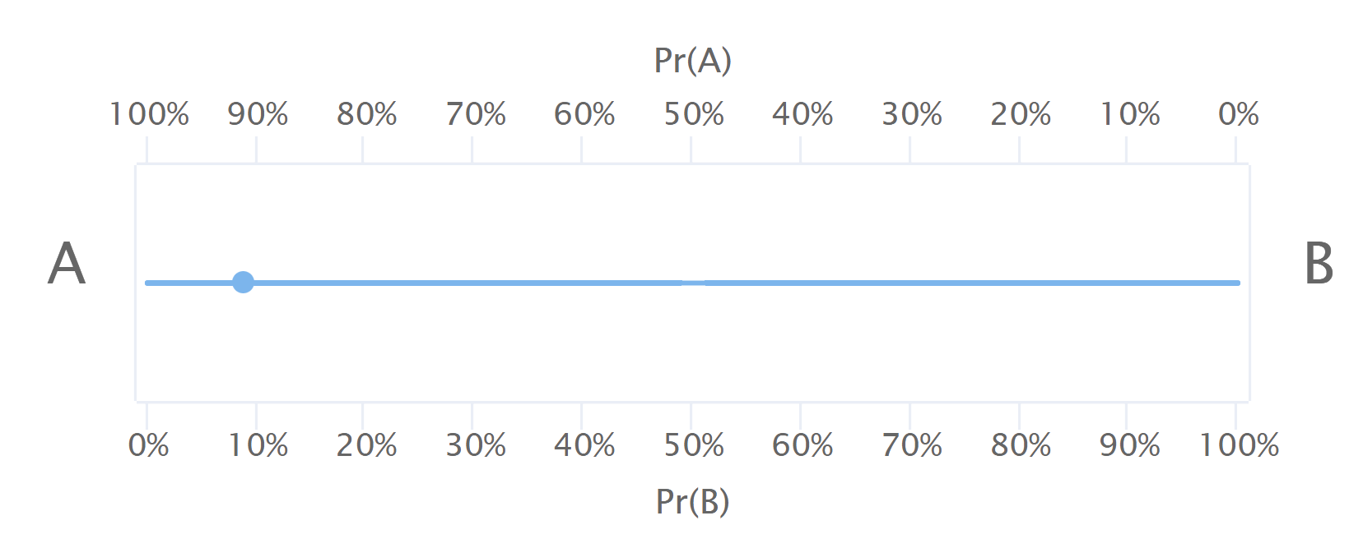
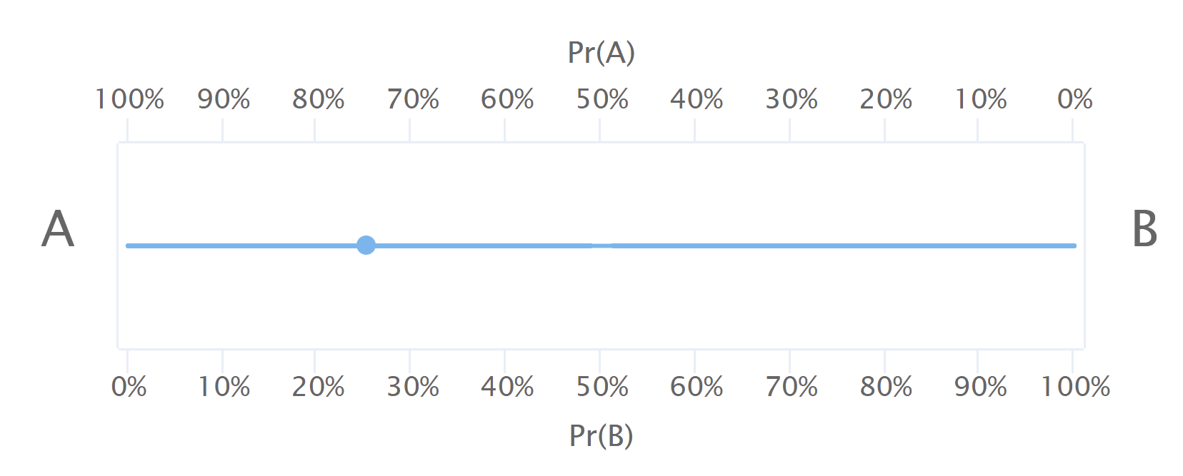
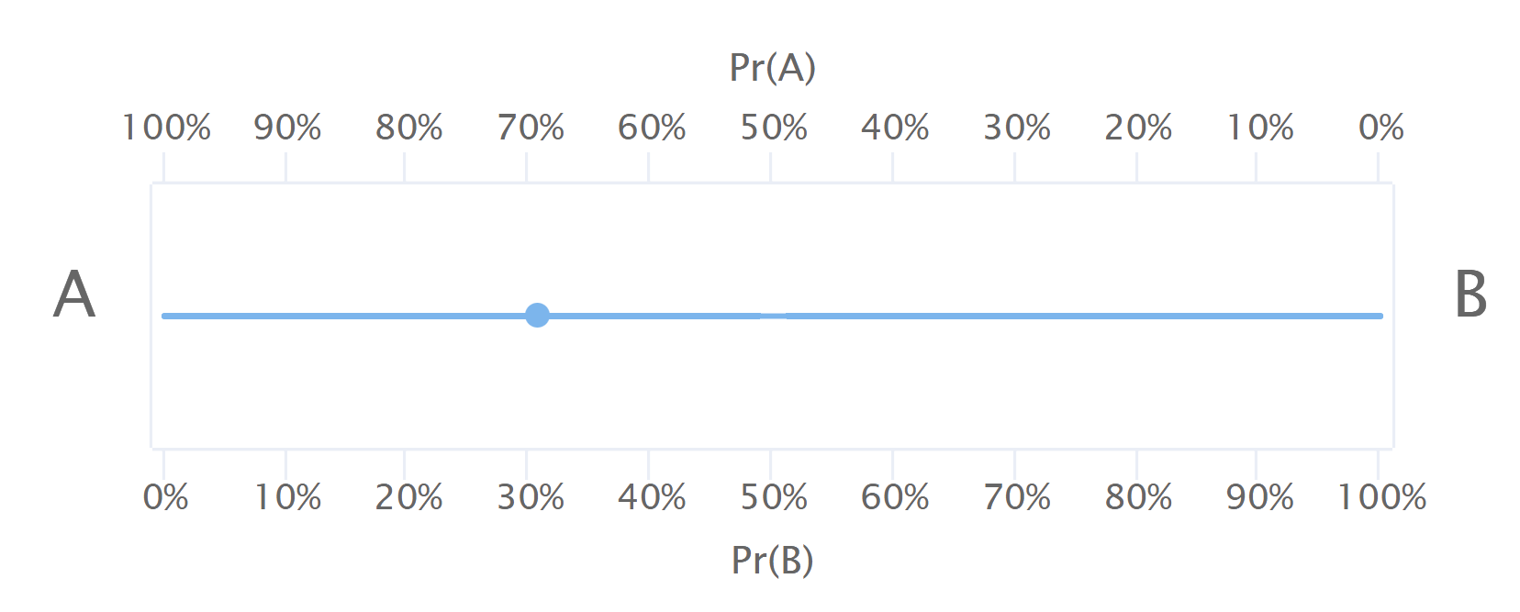
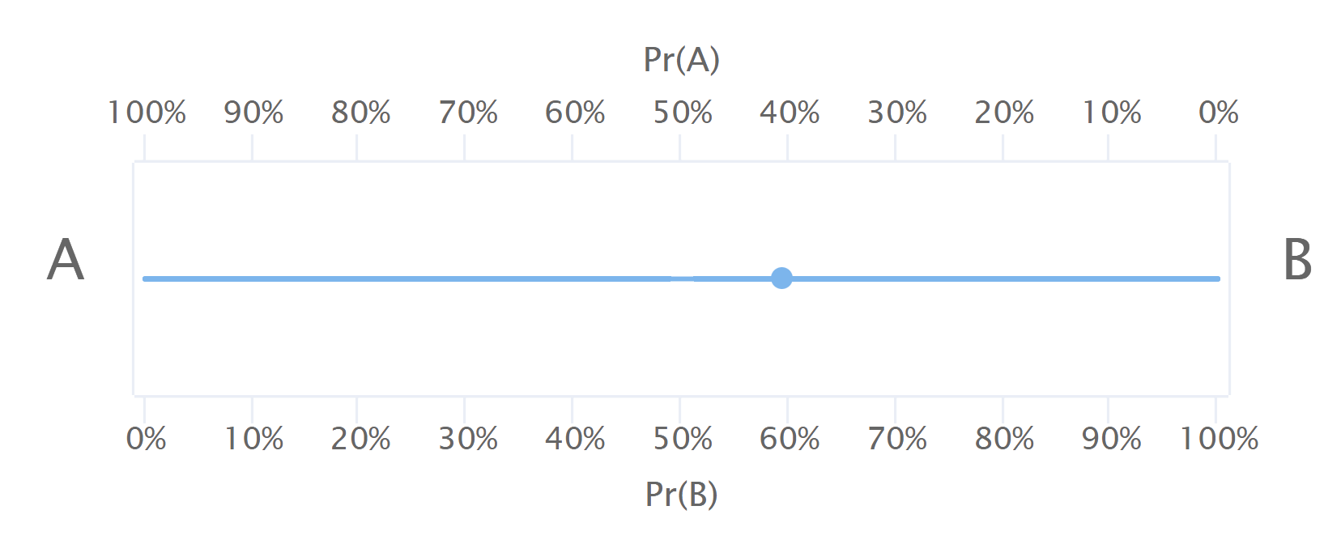

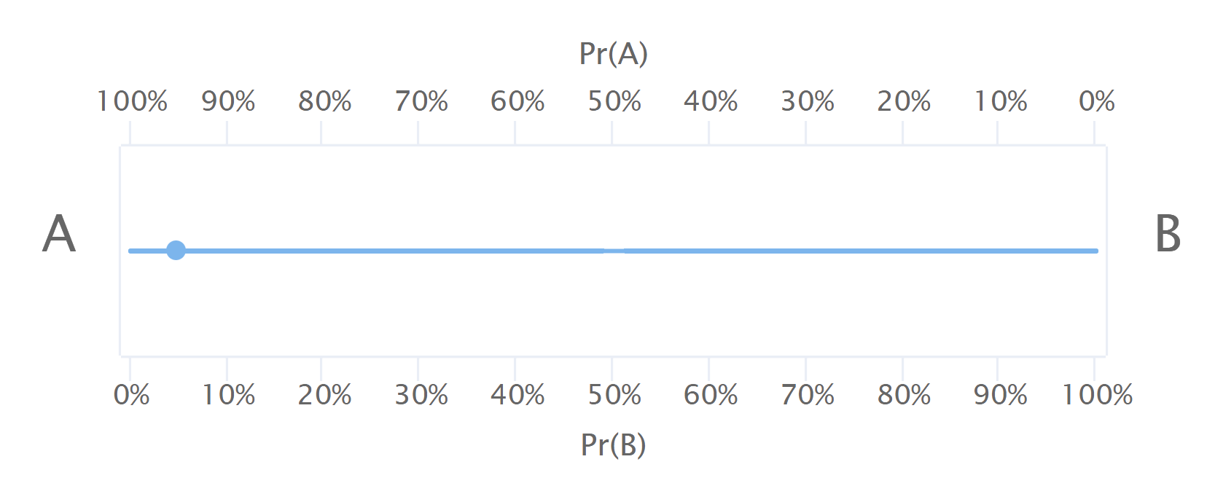
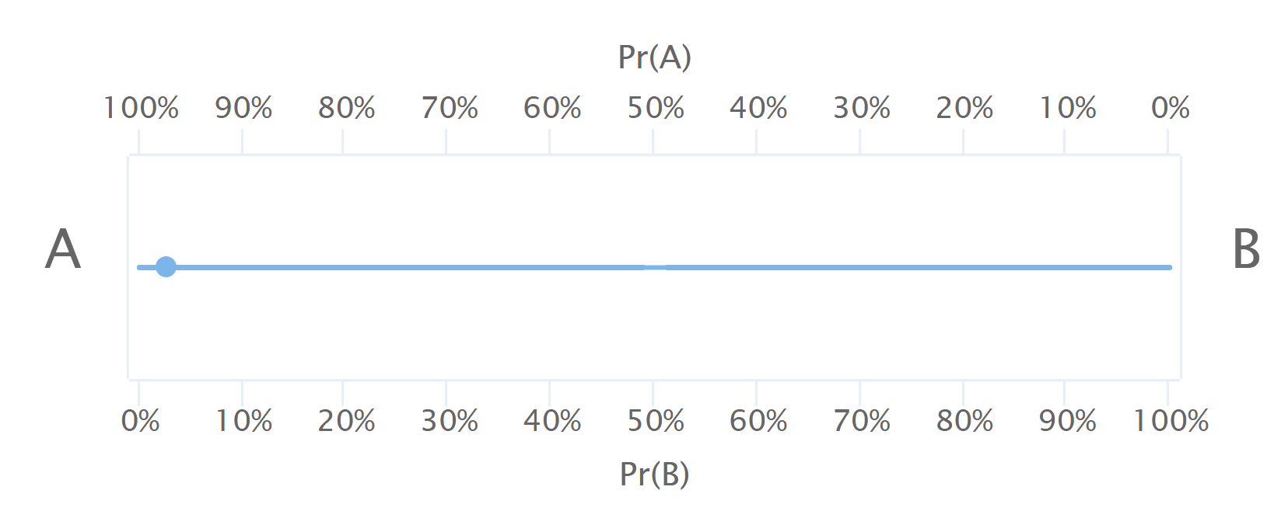
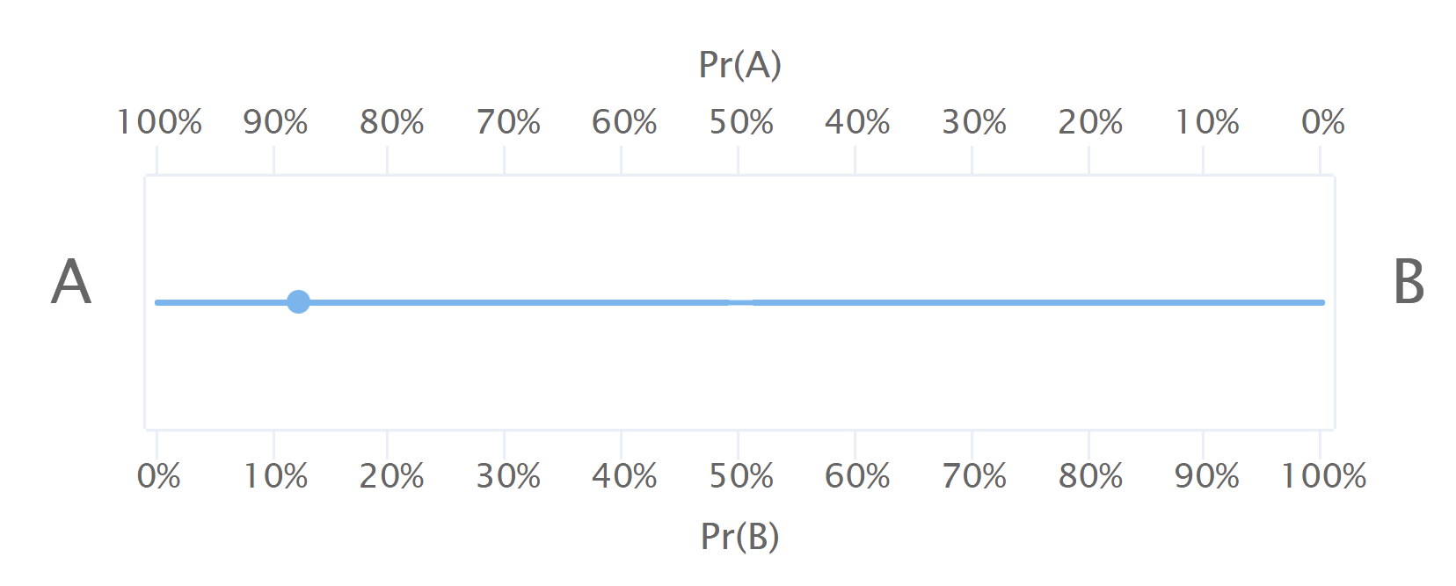
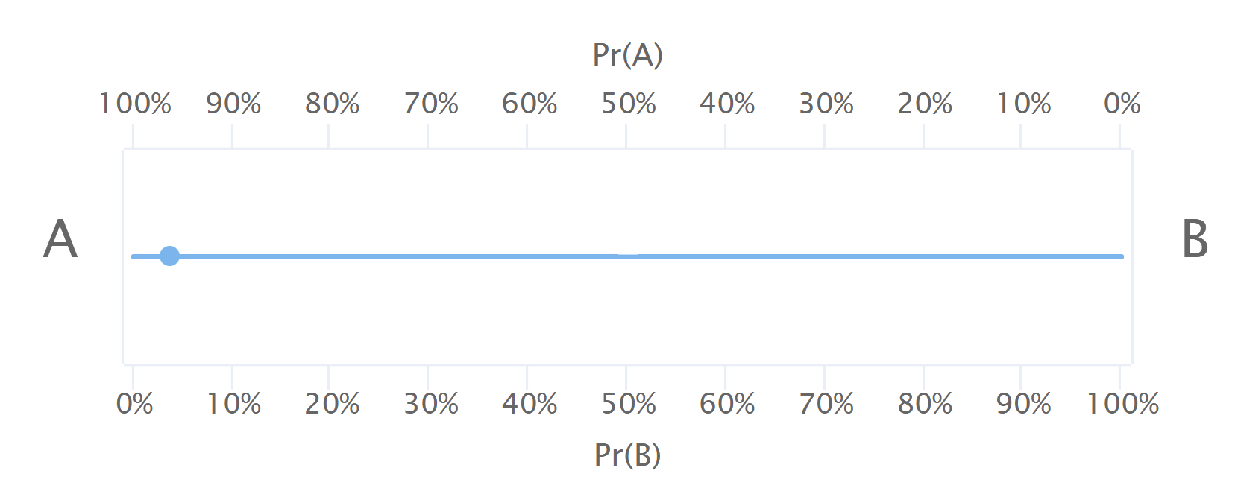
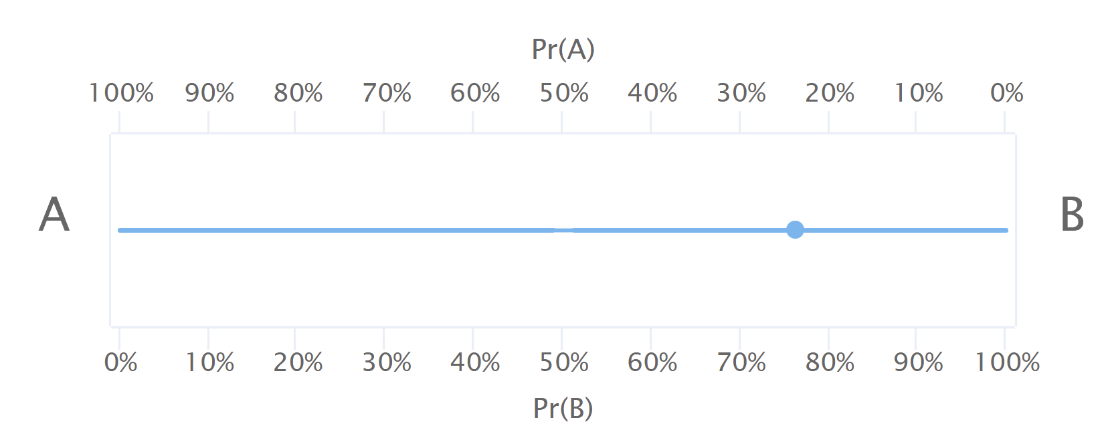
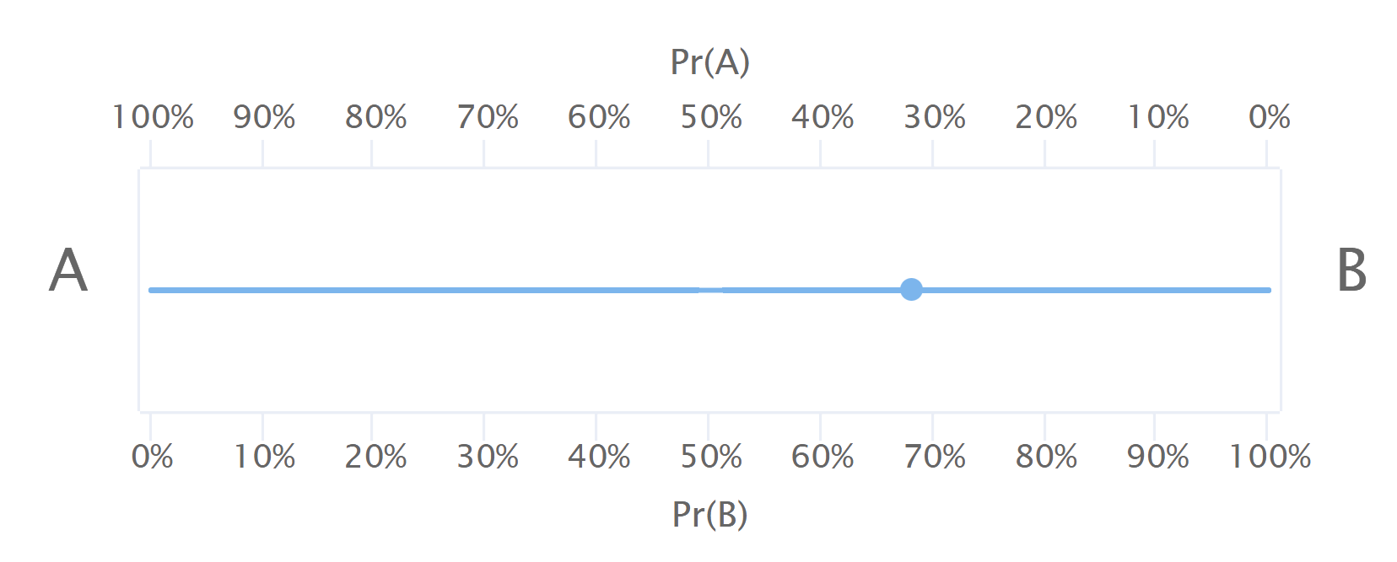
Examples

Slide 32
Information Costs
If your group correctly guesses the selected jar, you will receive 200 tokens.
However, with each passing minute you will lose 40 tokens (information costs).

Slide 33
Examples 1
Suppose your group guesses immediately that the jar is A.
Your guess will be correct with 50% probability.
You will not pay any costs.
Your overall expected payoff is: 0.5 x 200 – 0 = 100

Slide 34
Examples 2
Suppose your group guesses after 30 seconds, when the probability of Jar A selected is 70% .
Your guess will be correct with 70% probability.
You will pay 40 x ½ = 20 tokens for information.
Your overall expected payoff is: 0.7 x 200 – 20 = 120

Slide 35
Examples 3
Suppose your group guesses after one minute, when the probability of Jar A selected is 80% .
Your guess will be correct with 80% probability.
You will pay 40 x 1 = 40 tokens for information.
Your overall expected payoff is: 0.8 x 200 – 40 = 120

Slide 36
Group Decision
At the beginning of each round, you will be randomly grouped with two other individuals.
The software will select the jar randomly, A and B equally likely.
Your group members change at random from round to round, as does the state.

Slide 37
Group Decision within a round
As long as a decision has not been made, you and your group members will see the same information.
The costs of information will be 40 tokens per minute for each of you.
At any point in time, you can choose whether you would like to
  Stop and guess A;
  Stop and guess B;
  Wait—choose W—and collect more information at a cost of 40 tokens per minute.
You can change your mind as long as a decision has not been made.
You will be able to see what your group members are choosing throughout.

Slide 38
Group Decision
Once all members of your group choose either A or all members of your group choose B, information collection will stop and that will be the group’s decision:
  If all 3 members in your group choose A, your group’s guess is A
  If all 3 members in your group choose B, your group’s guess is B

Slide 39
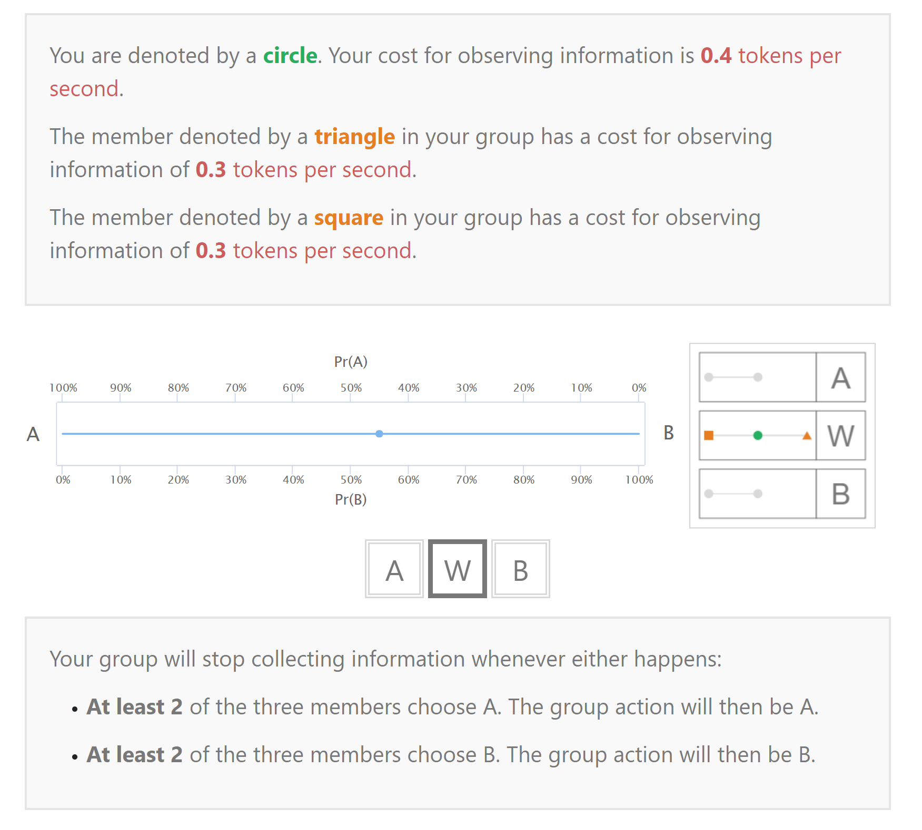
Interface

Slide 40
Post-Experiment
You will be paid the sum of your payoffs across 20 randomly selected rounds (excluding the practice round).
You will also be asked to complete several simple tasks at the end. You can earn additional money based on your decisions in these tasks.

Slide 41




Your Earnings
Your total earnings in the experiment are the sum of the following amounts:
$10 show-up payment
payoff from 20 out of 30 randomly selected real rounds:
100 tokens = 1 dollar
payoff from the simple tasks:
100 token = 1 dollar
You need not tell any other participant how much you earned.

Slide 42
Let the Experiment Begin!
If there are no questions, we will now begin the
actual experiment.

Slide 43
THANK YOU!
Thank you for your participation!
We hope you will tell your friends.
We will give you a coupon code on your way out. Any friend who signs up for the first time and submits this code will receive $5 when completing their first session at PExL.
Every time you complete a session, you will receive $5 for every new friend you get to sign up for the first time till that session.
Valid till the end of the Spring 2018 semester.

Slide 44
THANK YOU!
Thank you for your participation!
We hope you will tell your friends.
We will give you a coupon code on your way out. Any friend who signs up for the first time and submits this code will receive $5 when completing their first session at PExL.
Every time you complete a session, you will receive $5 for every new friend you get to sign up and complete a session since your last session.
Valid till the end of the Spring 2019 semester.

